Slide 1
Artificial intelligence systems Lecture 4 Knowledge representation
Associate professor of SEMIT department,
Ph.D.. Goloskokova Anna

Slide 2
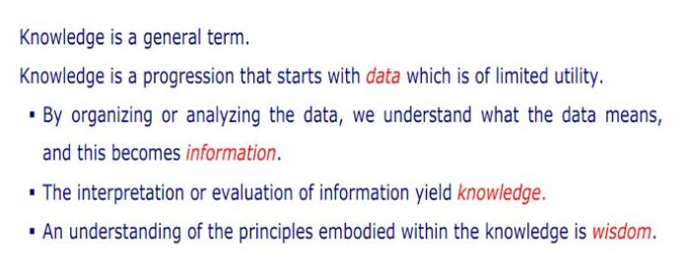
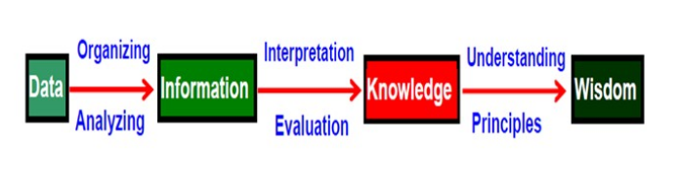
INTRODUCTION

Slide 3
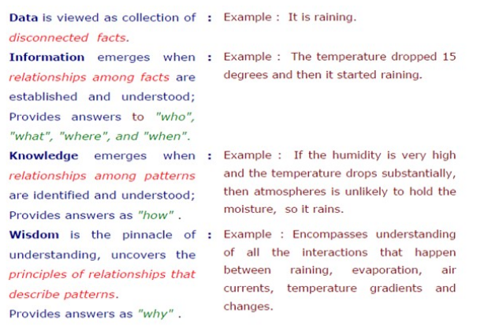
DATA-INFORMATION-KNOWLEDGE-WISDOM

Slide 4
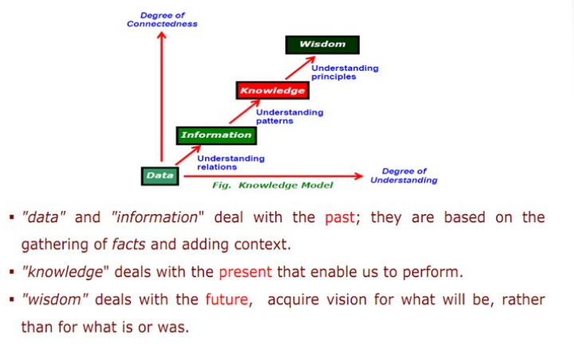
DATA-INFORMATION-KNOWLEDGE-WISDOM

Slide 5
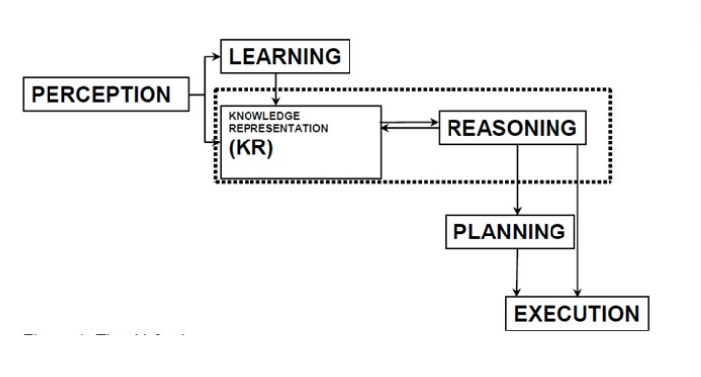
THE AI CYCLE

Slide 6
+25 slides
To continue use the following link:
https://www.slideshare.net/RamlaSheikh/knowledge-representation-in-artificial-intelligence

Slide 7
Home task
Prepare a report + presentation:
A Knowledge representation model
(Logistic, production, semantic, frames) – use one of the list
- history (the reason of its creation)
- structure of a model
- what kind of tasks could be solved with this model
- advantages/ disadvantages
- a solution of real example (!!!!!!!!!!!!!!!!!!!!!!)

